Slide 1
Optimizing Global Freight: Machine Learning Predictions for Transit Times
By: Atziri Mendoza, Binod Gaihre, Sage Hanson

Slide 2

What even is Logistics?
getting the right things to the right place at the right time, using the most effective and cost-efficient methods.

Slide 3

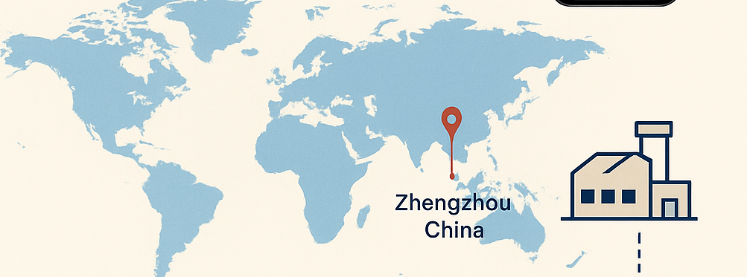


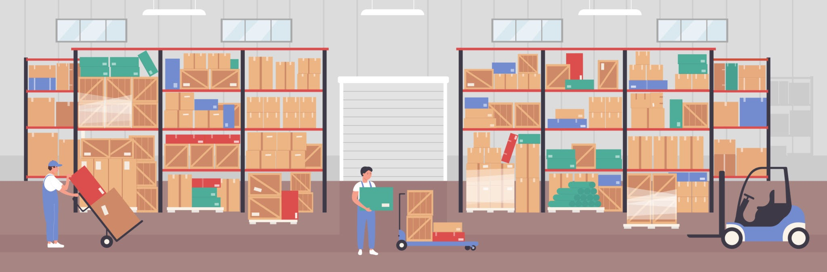
iPhone Journey
Think about the journey these take to get to our hands!
Order your iPhone
Step 1. Assembling
The journey of the iPhone begins
Assembled in Zhengzhou China
Step 2. Shipped Across Oceans
Step 3. The Final Mile
iPhone is packages and sent on a freight ship to the US.
iPhones get transported from the port to the distribution warehouse.
Notes:
You order your iPhone and it is at your door in a few days! The phone doesn’t teleport, it undergoes a journey.

Slide 4
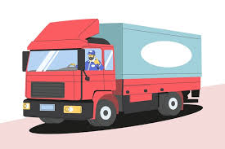




Shipment Steps
This is how the magic happens!
Step 1:
Warehouse
Step 2:
Ground Transport
Step 3:
Port Arrival
Step 4:
Ocean Transport
Step 5:
Repeat Steps 3-1

Slide 5
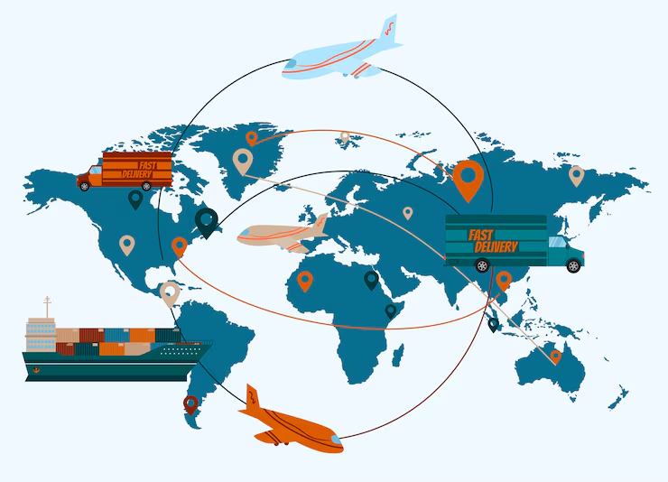
Logistic Solutions for our client Flexport

Slide 6
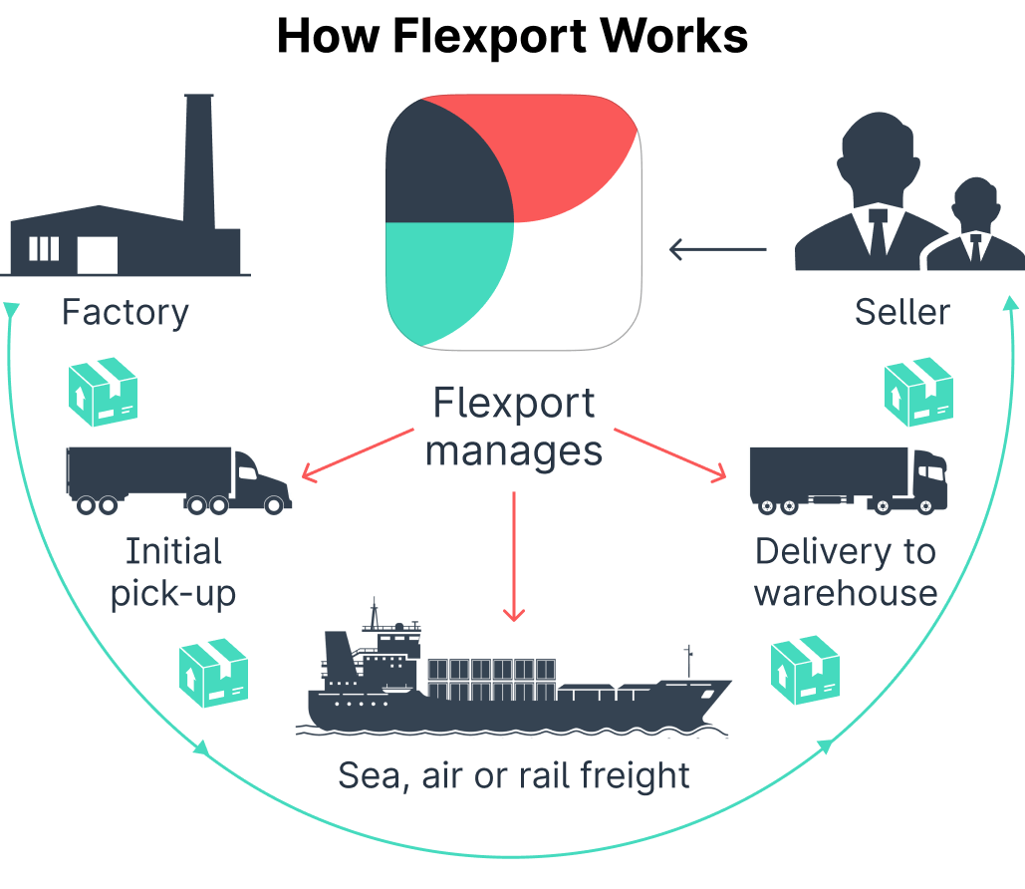
What Is Flexport?
The problem we are solving:
Freight Forwarding - It’s really Freight Email Forwarding
Unstructured data
isolated data
poor visibility
poor data analytic capabilities

Slide 7
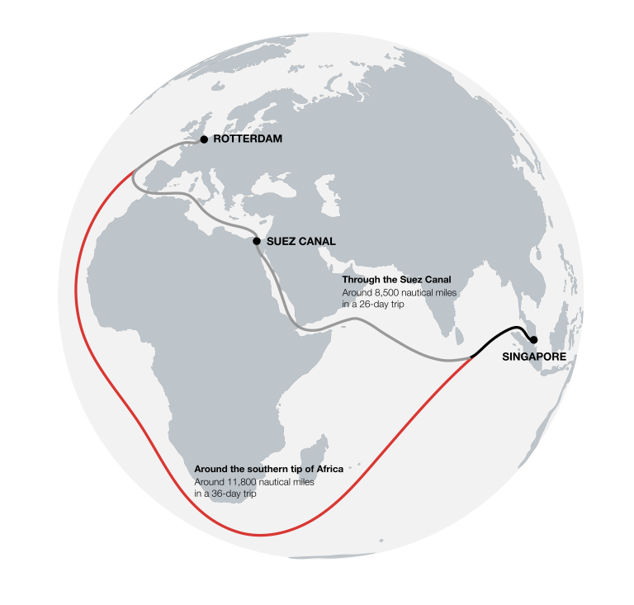
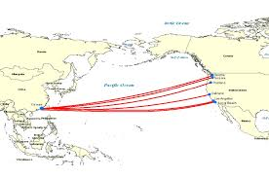
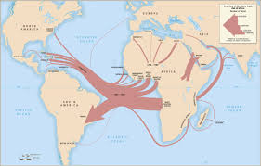
What Are Trade Lanes?
Transatlantic Westbound (TAWB)
Far East Westbound (FEWB)
Trans Pacific West Bound (TPEB)

Slide 8




Key Objectives
Increase Client Trust
Predict Transit Days for SE Asian Countries
Make a Random Forest Regression
Implement our model in Flexport
We want to give our clients a better time estimate- time is money afterall
Focused Tradelanes: TPEB, FEWB, TAWB
This model should be able to predict the total days it takes for our shipment
With this model Flexport will be able to give a more accurate time estimate than it was once doing before becoming more reliable
Companies trust
Give an accurate time on shipment
impacts planning, customer satisfaction, cost

Slide 9
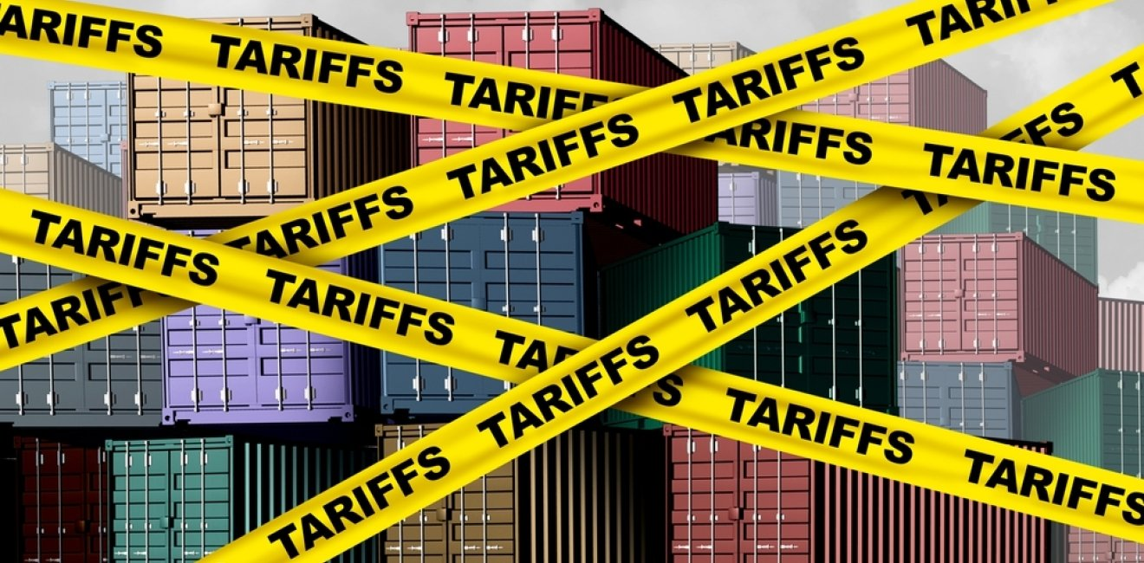
Tariffs
The US is imposing tariffs on other countries goods! This will have an impact on the global transportation of goods that will end up hurting our pockets.
Having data on smaller SouthEast Asian countries will be important because of the tariffs imposed on China. We need higher accuracy.

Slide 10
Random Forest Regression

Slide 11

Data Source
(Flexport)
Predictions
TPEB
Actual - 10 days
Predicted - 5.72 days
FEWB
Actual - 13 days
Predicted - 6.48 days
TAWB
Actual - 12.5 days
Predicted - 8.32 days
Data Engineering|
Geo-DIstance
Land-Distance
Weight-to-Volume Ratio
Outliers Removal
Random Forest Regression Model

Slide 12
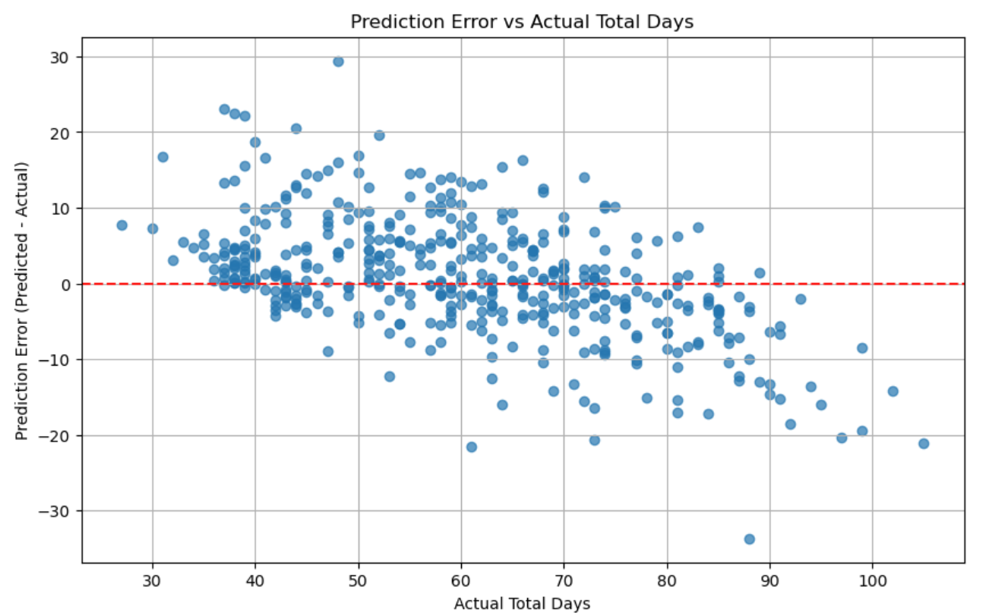
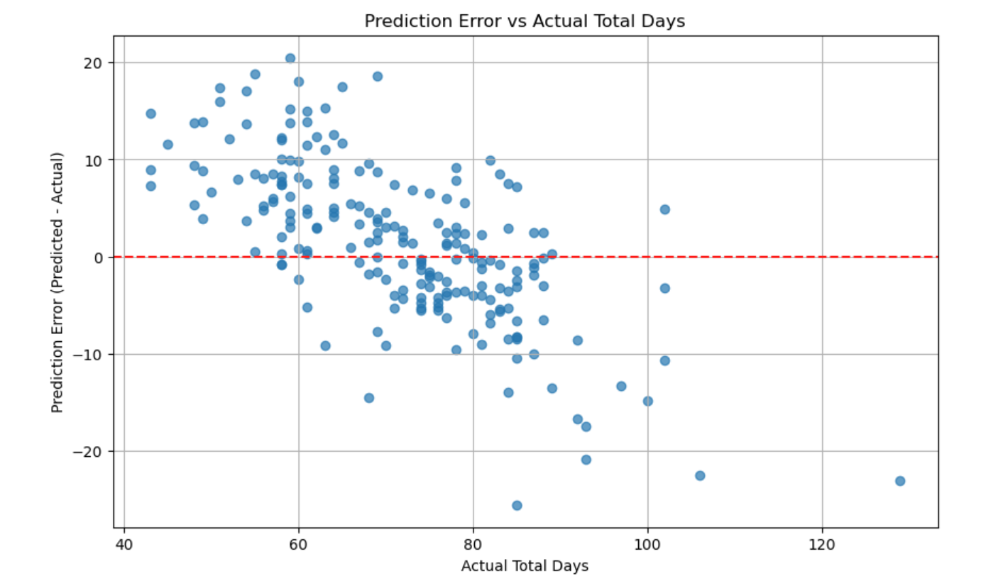
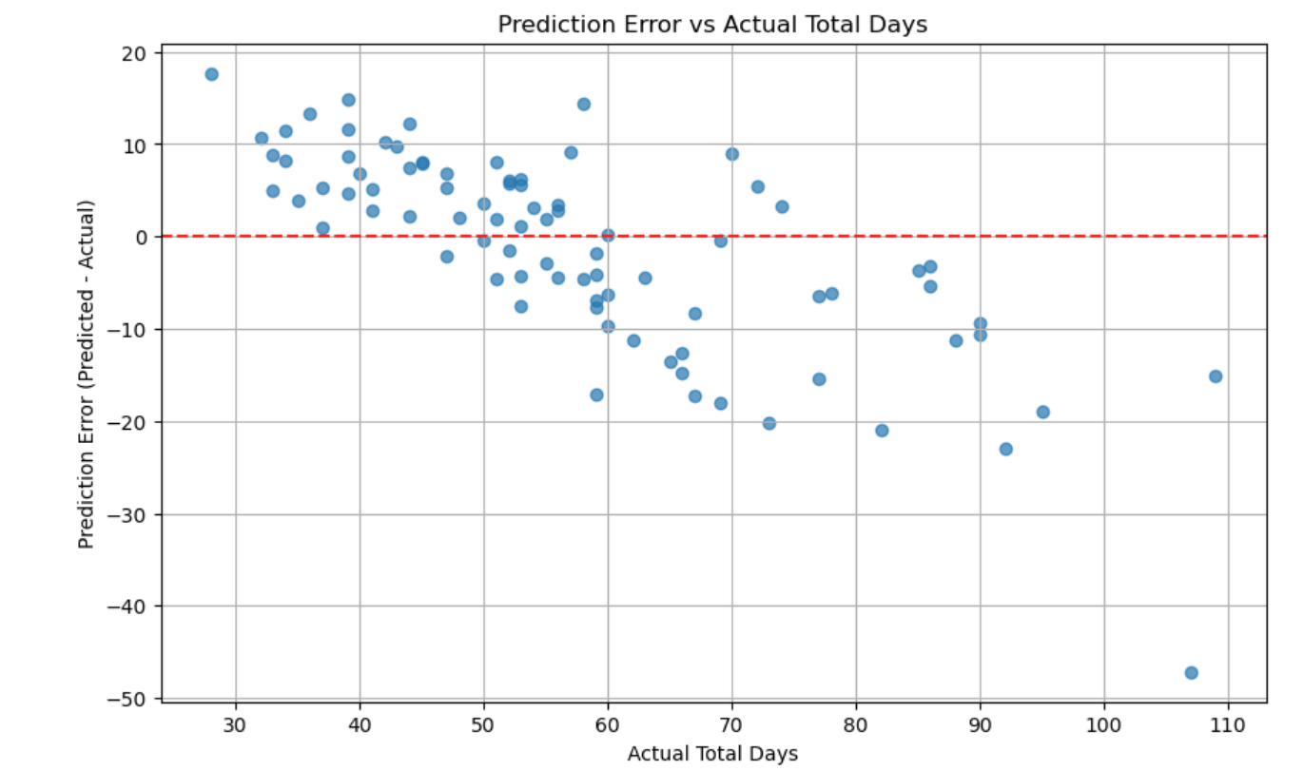
Results
TPEB Tradelane Results
FEWB Tradelane Results
TAWB Tradelane Results
Present : 10 days
MAE: 5.72 days
R2: 0.7583
Present: 13 days
MAE: 6.48 days
R2: 0.6081
Present: 12.5 days
MAE: 8.31
R2: 0.6330

Slide 13
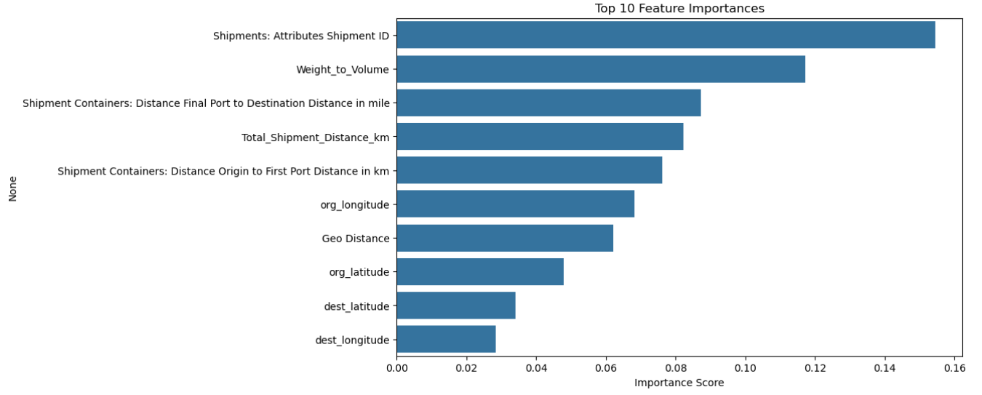
Feature Analysis
Process of evaluating the variables (features) used in a machine learning model
Goals:
Identify most influential features
Detect irrelevant or redundant features
Understand relationships between features and target
Determine whether any features can be removed, transformed, or engineered to improve model performance

Slide 14
LIMITATIONS
Limited Data
Primary Key used as Feature
Variables outside the Data
13 weeks of Data
Model may better predict w/ more data Reducing Mean Absolute Error
Unaccounted variables that could cause potential issues in predictions
Variables not included in our limited data
Shipment ID is a primary key that was included in the features but we are doubtful that it's actually a predictor
waiting on Flexport to verify
Notes:
Limited Data
Our current data set is limited to 13 weeks but if we can train our model with a year’s worth of data. We could possibly further reduce Mean Absolute Error.
Variables Outside the Data
There are variables that are not accounted for in the data. That would potentially delay our shipping times, such as government policies, issues in customs, storms at sea, workers calling off sick, strikes, etc.

Slide 15

Saving Sage’s Job
Binod
Sage
ChatGPT
Binod
Atziri
MONTH 20XX
Freight Forwarding - It’s really Freight Email Forwarding
Unstructured data, isolated data, poor visibility, poor data analytic capabilities

Slide 16

Q&A
April 2025
COMPANY NAME
EXAMPLE.COM
@[INSERT HANDLE HERE]

